Slide 1
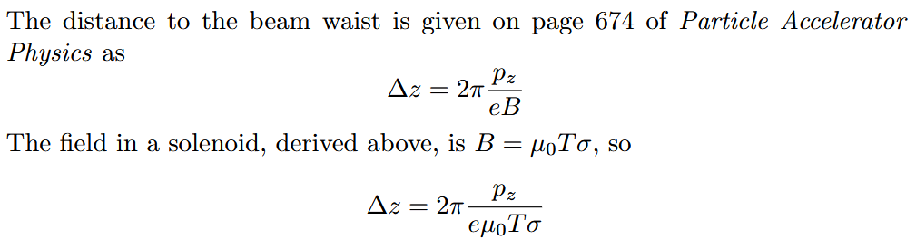
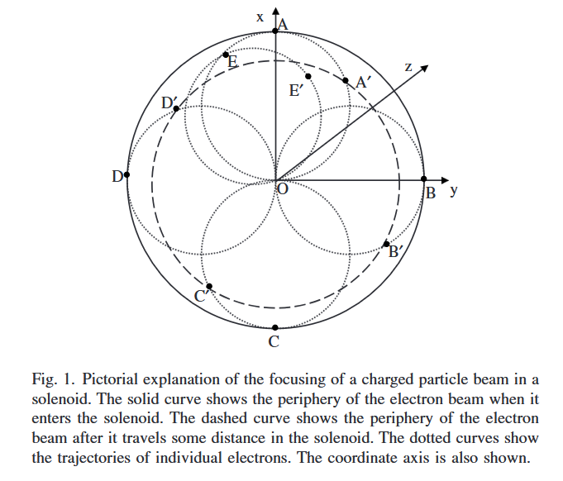
Calculation of focal point
With pz = 100 MeV
T = 175 mm
σ = 90 A/mm
We get z = 105.893 mm

Slide 2
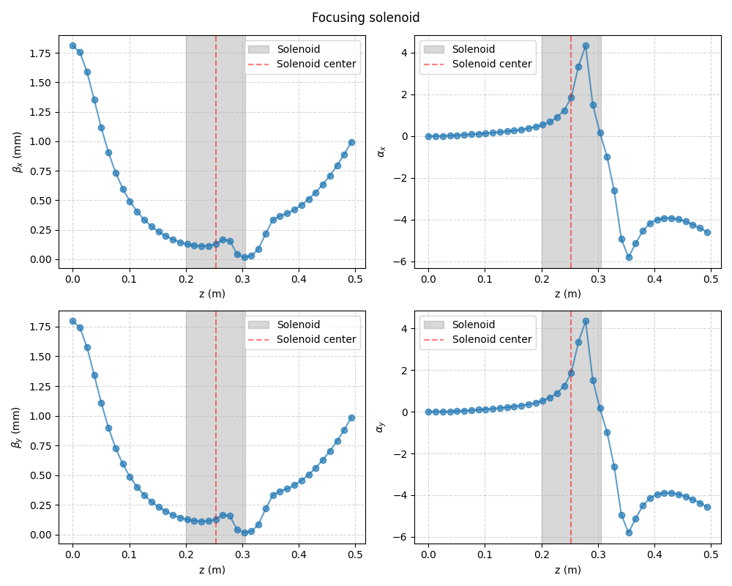
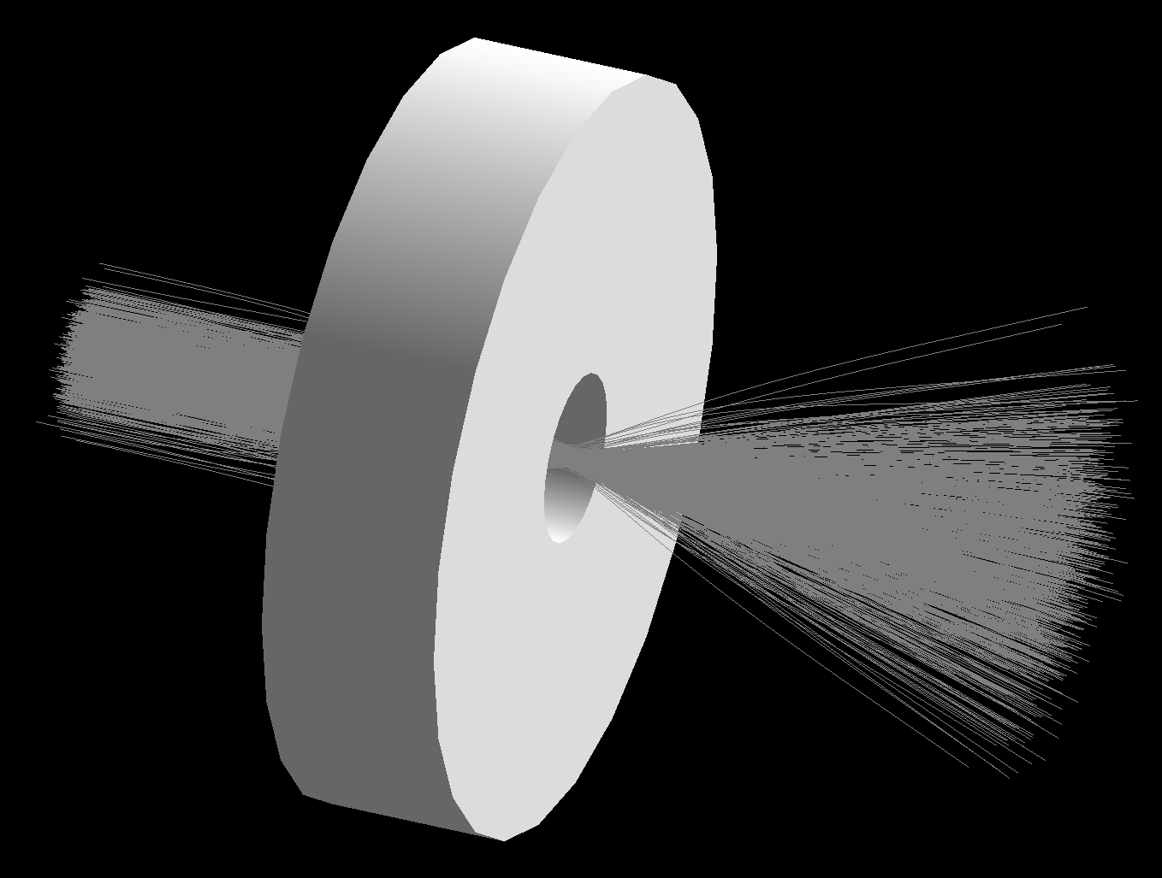
length=z solenoid

Slide 3
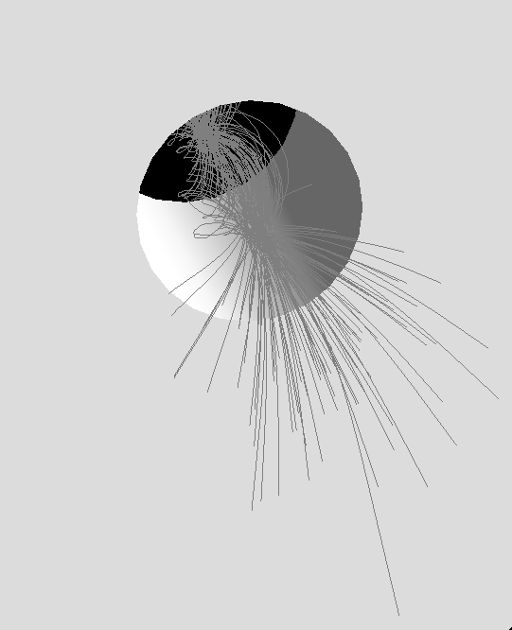
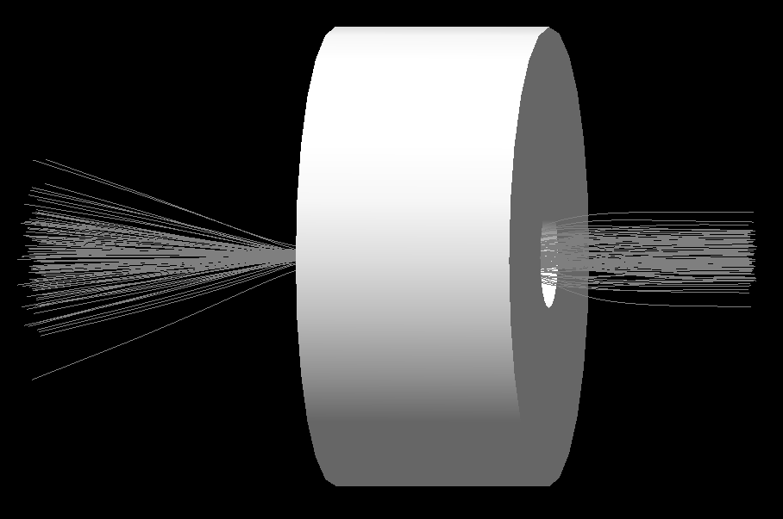
length=2z solenoid

Slide 4
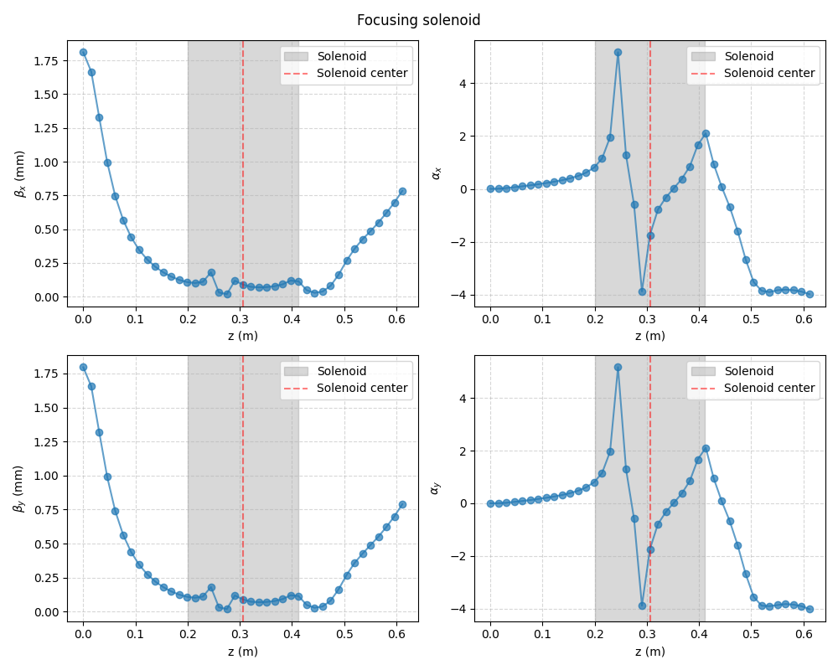
length=2z solenoid
Why does beta decrease before the beam enters the solenoid?
Why is there a sharp dip in beta right before the centerpoint?

Slide 5
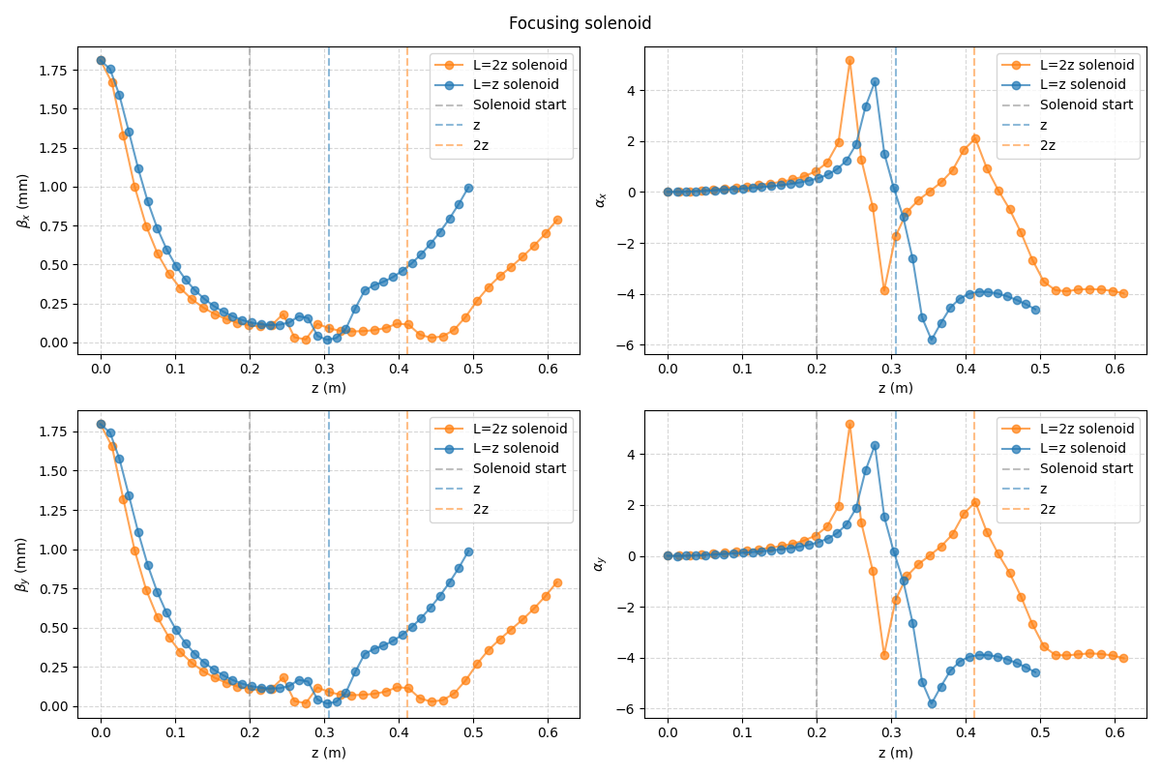
Both on same graph
The L=2z case reaches a minimum in beta earlier than the L=z case. Why is that?

